Slide 1
Surveillance for serious bacterial diseases

Slide 2
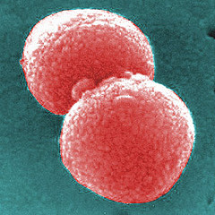
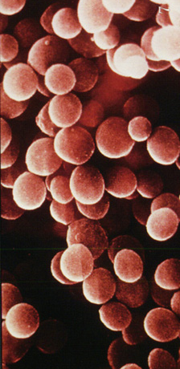
Overview of Active Bacterial Surveillance
What we do: Identify serious illness among Native Americans caused by four germs
Streptococcus pneumoniae
Haemophilus influenzae
Neisseria meningitidis
Staphylococcus aureus
Why we do it: Track changes in illness over time and evaluate the impact of interventions on illness
Streptococcus pneumoniae
Haemophilus influenzae
Staphylococcus aureus
Neisseria meningitidis

Slide 3
Overview of Active Bacterial Surveillance
How we do it: Contact laboratories to identify cases of serious illness
Where we do it: 24 laboratories on and around the Navajo Nation and White Mountain Apache Tribal lands
UTAH
COLORADO
ARIZONA
Albuquerque
Phoenix
NEW MEXICO
Key:
Navajo Nation
White Mountain Apache
Hopi
Laboratory

Slide 4
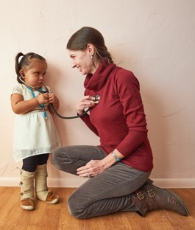
Spotlight on H. influenzae type b (Hib)
Hib causes serious illness like pneumonia, meningitis, and blood infections
Since 1991, children are vaccinated against Hib
Hib vaccine given at 2, 4, and 12-15 mos.
Children are at highest risk of Hib illness

Slide 5
Hib vaccine had powerful impact, but important to keep tracking disease
Since Hib vaccine use began, it has prevented an estimated 1,000 cases of serious illness on Navajo Nation, but disease remains much higher than the general US population
Before Hib vaccine
After Hib vaccine
Notes:
Hib vaccine has been very successful in decreasing the amount of serious Hib disease in children in our communities
The last case of Hib disease in children occurred in 2013 among White Mountain Apache children and in 2016 among Navajo children
Hib disease has not been totally eliminated even in children getting the vaccine. Our team is studying why this might be—and what we can do, with federal, state and local partners, to work toward disease elimination.

Slide 6
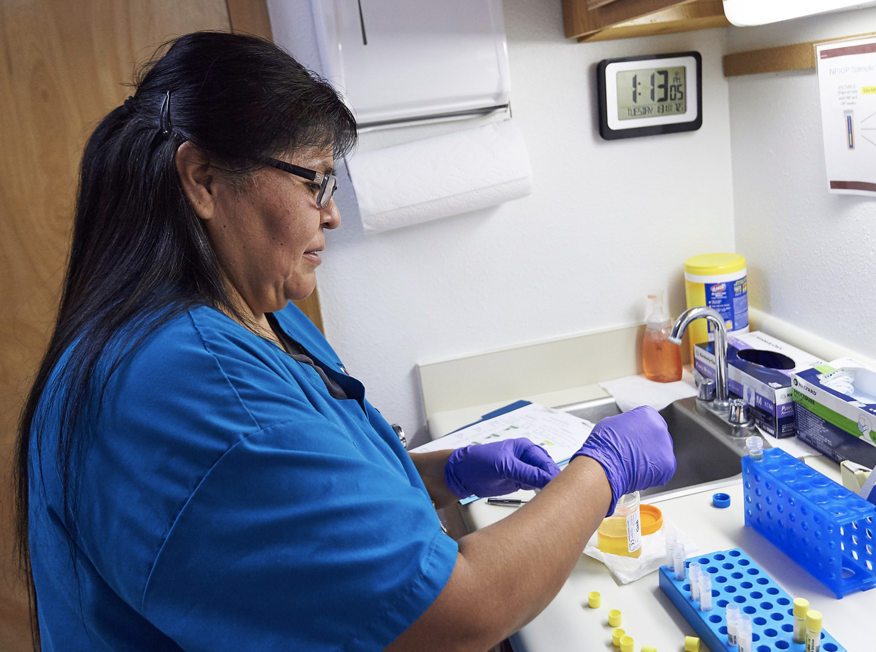
Continued surveillance is critical
Even though vaccines have lowered disease, continued tracking alerts us to changes in disease trends and allows us to proactively work with local health providers in response

Slide 7
Important contributions of this work
Our surveillance project has led to:
Vaccine-specific policies for Native Americans
Prioritization of Native Americans in times of vaccine shortages
Increased attention on indigenous health worldwide

